Slide 1
Use Case Diagrams

Slide 2
What is UML?
Standard language for specifying, visualizing, constructing, and documenting the artifacts of software systems, business modeling and other non-software systems.
The UML represents a collection of best engineering practices that have proven successful in the modeling of large and complex systems.
The UML is a very important part of developing object oriented software and the software development process.
The UML uses mostly graphical notations to express the design of software projects.
Using the UML helps project teams communicate, explore potential designs, and validate the architectural design of the software.

Slide 3

Overview of UML Diagrams
Behavioral
: behavioral features of a system / business process
Activity
State machine
Use case
Interaction
Structural
: element of spec. irrespective of time
Class
Component
Deployment
Object
Composite structure
Package
Interaction
: emphasize object interaction
Communication(collaberation)
Sequence
Interaction overview
Timing

Slide 4
Use Cases
What is a Use Case
  A formal way of representing how a business system interacts with its environment
  Illustrates the activities that are performed by the users of the system
  A scenario-based technique in the UML
  A sequence of actions a system performs that yields a valuable result for a particular actor.

Slide 5
Use Case Analysis
What is an Actor?
  A user or outside system that interacts with the system being designed in order to obtain some value from that interaction
Use Cases describe scenarios that describe the interaction between users of the system (the actor) and the system itself.

Slide 6
Use Cases
Use case diagrams describe what a system does from the standpoint of an external observer. The emphasis is on what a system does rather than how.
Use case diagrams are closely connected to scenarios. A scenario is an example of what happens when someone interacts with the system.

Slide 7
Use Cases
Here is a scenario for a medical clinic.
A patient calls the clinic to make an appointment for a yearly checkup. The receptionist finds the nearest empty time slot in the appointment book and schedules the appointment for that time slot. "
We want to write a use case for this scenario.
Remember: A use case is a summary of scenarios for a single task or goal.

Slide 8
Use Cases
Step 1 Identify the actors
As we read the scenario, define those people or systems that are going to interact with the scenario.
A patient calls the clinic to make an appointment for a yearly checkup. The receptionist finds the nearest empty time slot in the appointment book and schedules the appointment for that time slot. "

Slide 9
Use Cases
Step 1 Identify the actors
As we read the scenario, define those people or systems that are going to interact with the scenario.
A patient calls the clinic to make an appointment for a yearly checkup. The receptionist finds the nearest empty time slot in the appointment book and schedules the appointment for that time slot. "

Slide 10
Questions for Identifying People Actors
Who is interested in the scenario/system?
Where in the organization is the scenario/system be used?
Who will benefit from the use of the scenario/system?
Who will supply the scenario/system with this information, use this information, and remove this information?
Does one person play several different roles?
Do several people play the same role?
Notes:
Actors
7) Does one person play several different roles?
May have an actor for each role
8) Do several people play the same role?
Only use one actor per role (no matter how many people play that role)
Identifying actors is an iterative process
Defining how an actor interacts with the system may clarify whether there are duplicate actors or not

Slide 11
Questions for Identifying Other Actors
What other entity is interested in the scenario/system?
What other entity will supply the scenario/system with this information, use this information, and remove this information?
Does the system use an external resource?
Does the system interact with a legacy system?
Notes:
Actors
7) Does one person play several different roles?
May have an actor for each role
8) Do several people play the same role?
Only use one actor per role (no matter how many people play that role)
Identifying actors is an iterative process
Defining how an actor interacts with the system may clarify whether there are duplicate actors or not

Slide 12
Actors
An Actor is outside or external the system.
It can be a:
  Human
  Peripheral device (hardware)
  External system or subsystem
  Time or time-based event
Represented by stick figure
Notes:
Actors
Are NOT a part of the system (external to the system)
A single actor may represent multiple physical users
Whether human or not, represented by stick figure
MUST label stick figure with the name of the actor

Slide 13
Use Cases
A use case is a summary of scenarios for a single task or goal.
An actor is who or what initiates the events involved in the task of the use case. Actors are simply roles that people or objects play.
So as we read our scenario, what or who is the actor????

Slide 14

Use Cases
So as we read our scenario, what or who is the actor????
A patient calls the clinic to make an appointment for a yearly checkup. The receptionist finds the nearest empty time slot in the appointment book and schedules the appointment for that time slot. "
The actor is a Patient.

Slide 15
Use Cases
The use case is a summary of scenarios for a single task or goal.
So What is the Use Case????
The Use Case is Make Appointment.
It is a use case for the medical clinic.

Slide 16

Use Cases
The picture below is a Make Appointment use case for the medical clinic.
The actor is a Patient. The connection between actor and use case is a communication association (or communication for short).
Actors are stick figures. Use cases are ovals. Communications are lines that link actors to use cases.
Actors are stick figures. Use cases are ovals. Communications are lines that link actors to use cases.
Actors are stick figures. Use cases are ovals. Communications are lines that link actors to use cases.

Slide 17
Use Case Componentss
The use case has three components.
The use case task referred to as the use case that represents a feature needed in a software system.
The actor(s) who trigger the use case to activate.
The communication line to show how the actors communicate with the use case.

Slide 18
Use Case Diagram - Use Case
A major process performed by the system that benefits an actor(s) in some way
Models a dialogue between an actor and the system
Represents the functionality provided by the system
Notes:
Use Case
Represent the user functionality (not system functionality)

Slide 19
Use Case
Each use case in a use case diagram describes one and only one function in which users interact with the system
  May contain several “paths” that a user can take while interacting with the system
  Each path is referred to as a scenario
Notes:
Use Case
In reading a use case, you should not be able to tell if an activity is computerized or manual
Used to document the current system (AS-IS system) or the new system being developed (TO-BE system)
Communicates at a high level what the system needs to do
Captures the typical interaction of the system with the system’s users
Logical model
Physical details are defined during the design phase

Slide 20
Use Case
Labelled using a descriptive verb-noun phrase
Represented by an oval
Make
Appointment
Notes:
Use case: A use case in a use case diagram is a visual representation of a distinct business functionality in a system. The key term here is "distinct business functionality." To choose a business process as a likely candidate for modeling as a use case, you need to ensure that the business process is discrete in nature. As the first step in identifying use cases, you should list the discrete business functions in your problem statement. Each of these business functions can be classified as a potential use case. Remember that identifying use cases is a discovery rather than a creation. As business functionality becomes clearer, the underlying use cases become more easily evident. A use case is shown as an ellipse in a use case diagram Depicted by an oval
MUST label the oval with the name of the use case

Slide 21
Use Case - Actor
Labelled using a descriptive noun or phrase
Represented by a stick character
Notes:
Actors: An actor portrays any entity (or entities) that performs certain roles in a given system. The different roles the actor represents are the actual business roles of users in a given system. An actor in a use case diagram interacts with a use case. For example, for modeling a banking application, a customer entity represents an actor in the application. Similarly, the person who provides service at the counter is also an actor. But it is up to you to consider what actors make an impact on the functionality that you want to model. If an entity does not affect a certain piece of functionality that you are modeling, it makes no sense to represent it as an actor. An actor is shown as a stick figure in a use case diagram depicted "outside" the system boundary, as shown in Make Appointment figure.
Depicted by an oval
MUST label the oval with the name of the use case
To identify an actor, search in the problem statement for business terms that portray roles in the system. For example, in the statement "patients visit the doctor in the clinic for medical tests," "doctor" and "patients" are the business roles and can be easily identified as actors in the system.

Slide 22
Use Case - Relationships
Relationships
  Represent communication between actor and use case
  Depicted by line or double-headed arrow line
  Also called association relationship
Make
Appointment
Notes:
Use Case Relationship
Association relationship
May exist between actor and a use case
Often referred to as a communicate association
Navigable in both directions (actor to use case and use case to actor)
Some use just a line
Others use a double-headed arrowhead
Navigable in only one direction (actor to use case OR use case to actor)
Use a arrowhead where arrowhead denotes the direction of communication
Navigation direction of an association represents who is initiating the communication
Multiplicity
Not consistency shown on all use-case diagrams (Some do; some don’t)

Slide 23
Use Case - Relationships
Boundary
  A boundary rectangle is placed around the perimeter of the system to show how the actors communicate with the system.
Make
Appointment
Notes:
System boundary: A system boundary defines the scope of what a system will be. A system cannot have infinite functionality. So, it follows that use cases also need to have definitive limits defined. A system boundary of a use case diagram defines the limits of the system. The system boundary is shown as a rectangle spanning all the use cases in the system.
Other use cases in this lecture also show the system boundary of the clinic application. The use cases of this system are enclosed in a rectangle. Note that the actors in the system are outside the system boundary.
The system boundary is potentially the entire system as defined in the problem statement. But this is not always the case. For large and complex systems, each of the modules may be the system boundary. For example, for an ERP system for an organization, each of the modules such as personnel, payroll, accounting, and so forth, can form the system boundary for use cases specific to each of these business functions. The entire system can span all of these modules depicting the overall system boundary.

Slide 24
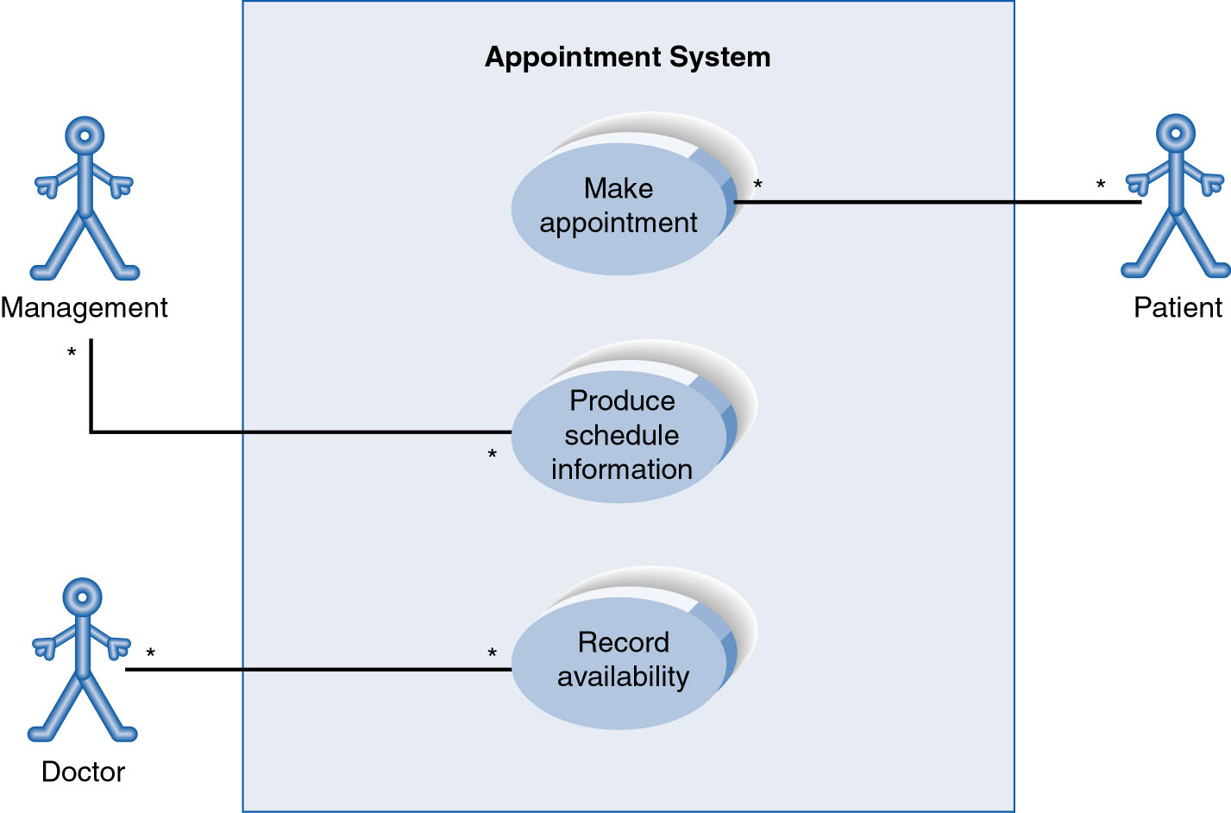
Use-Case Diagram
A use case diagram is a collection of actors, use cases, and their communications.
Notes:
Example Use Case
ACTORS
Represented by a stick figure
named
USE CASE
Represented by an oval
Named (POORLY NAMED; should be verb phrase)
RELATIONSHIP
2-way association

Slide 25
University Record System (URS)
A University record system should keep information about its students and academic staff.
Records for all university members are to include their id number, surname, given name, email, address, date of birth, and telephone number.
  Students and academic staff each have their own unique ID number: studN (students), acadN (academic employee), where N is an integer (N>0).
In addition to the attributes mentioned above:
  Students will also have a list of subjects they are enrolled in. A student cannot be enrolled in any more than 10 subjects.
  Academic employees will have a salary, and a list of subjects they teach. An academic can teach no more than 3 subjects.

Slide 26
Some Actions Supported by URS
The system should be able to handle the following commands.
  Add and remove university members (students, and academic staff)
  Add and Delete subjects
  Assign and Un-assign subjects to students
  Assign and Un-assign subjects to academic staff.

Slide 27
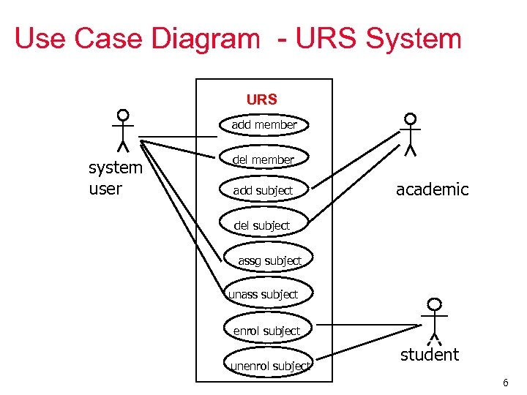

Slide 28
Use Case Diagram
Other Types of Relationships for Use Cases
  Generalization
  Include
  Extend
Notes:
Inheritance

Slide 29
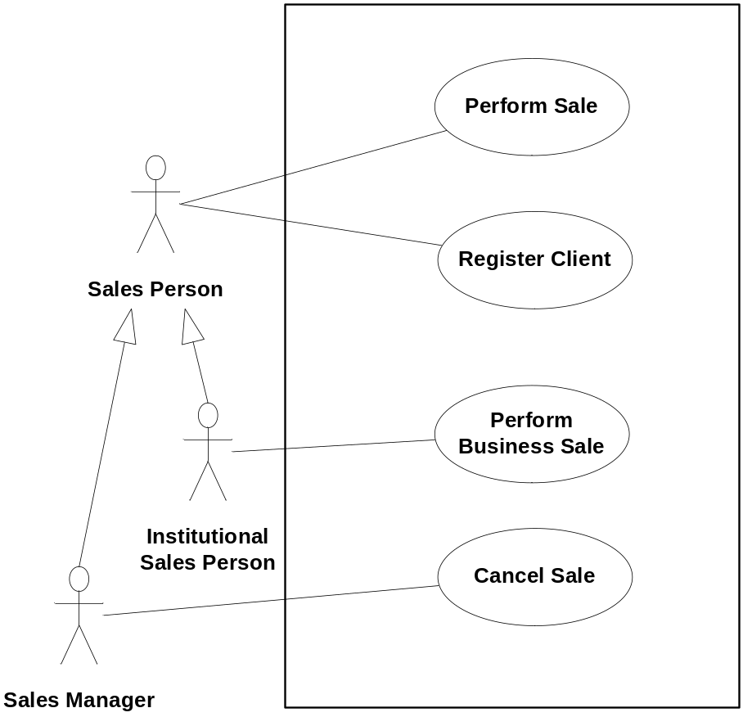
Actors can be generalized
Example
The child actor inherits all use-cases associations
Should be used if (and only if), the specific actor has more responsibility than the generalized one (i.e., associated with more use-cases)
Introduction | Diagrams | Writing | Guidelines
Notes:
A short exercise: do the generalization hierarchy of an e-learning system.

Slide 30
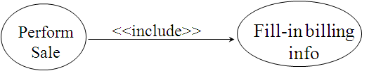
The “Include” Construct
Include is used when:
  Decomposing complicated behavior
  Centralizing common behavior
The base use case explicitly incorporates the behavior of another use case at a location specified in the base.
Perform Sale
Fill-in billing info
<<include>>

Slide 31
Extend – Graphical Representation
The base use case can incorporate another use case at certain points, called extension points.
Note the direction of the arrow
  The base use-case does not know which use-case extends it
<<extend>>
Product is a gift
Perform Sale
After checkout
Gift wrap Products

Slide 32
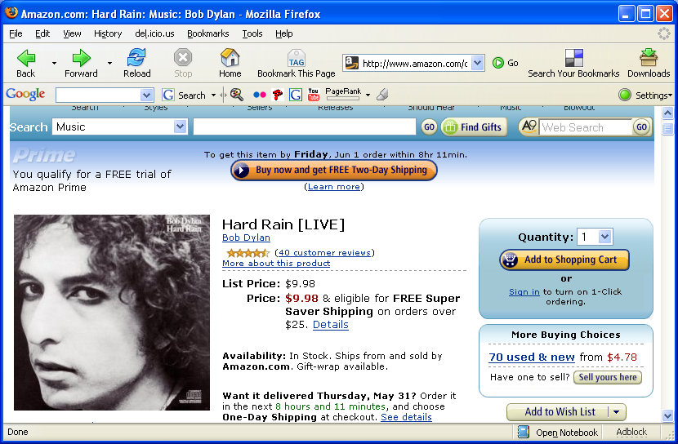
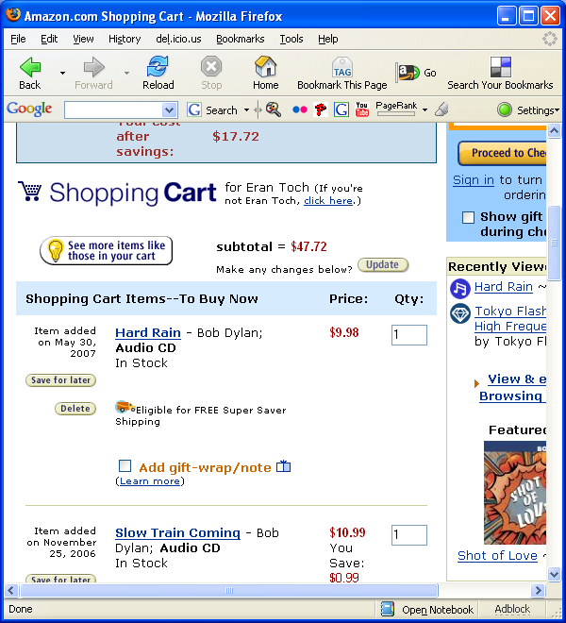
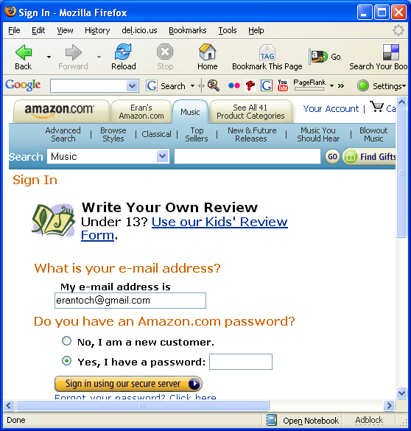
Example: Amazon
Shopping Cart
Product Page
Review Writing
Introduction | Diagrams | Writing | Guidelines
Notes:
TODO: add a search page before the product page
Think of Amazon, which functions are there. List them, and try to create a use-case from them.

Slide 33

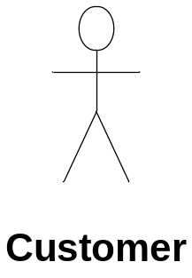
Example – cont’d
Rank Supplier
Search Product
«extend»
«include»
View Product Details
Write Review
After page generation
Navigate Deals
«include»
«extend»
Add to cart
«extend»
Checkout
«include»
«extend»
user is not
a member
Login
Register
Handle Order Status
«include»
Introduction | Diagrams | Writing | Guidelines
Notes:
Important points: Note that weak relations between use-cases are not mentioned. For instance, add to cart provides products to checkout, but the relation is not modeled. Also, the hierarchy between use-cases originates from the user perspective: Even though “View Product Details” is the central component from the programmers point of view, the user wants to search products or to see deals, and that the top use-case.
Use extend when:
You want to leave the important UC as simple as possible
For flexibility: we want to be able to add more features to important UCses.
When the extending UC is rare, it does not always happen.

Slide 34
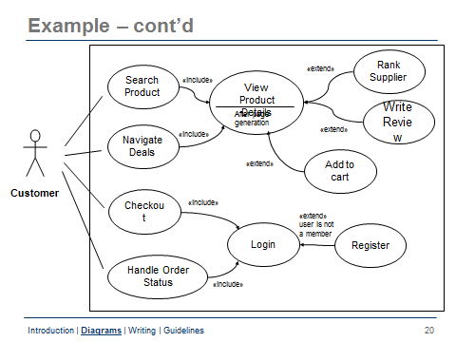
Notes:
Important points: Note that weak relations between use-cases are not mentioned. For instance, add to cart provides products to checkout, but the relation is not modeled. Also, the hierarchy between use-cases originates from the user perspective: Even though “View Product Details” is the central component from the programmers point of view, the user wants to search products or to see deals, and that the top use-case.
Use extend when:
You want to leave the important UC as simple as possible
For flexibility: we want to be able to add more features to important UCses.
When the extending UC is rare, it does not always happen.

Slide 35
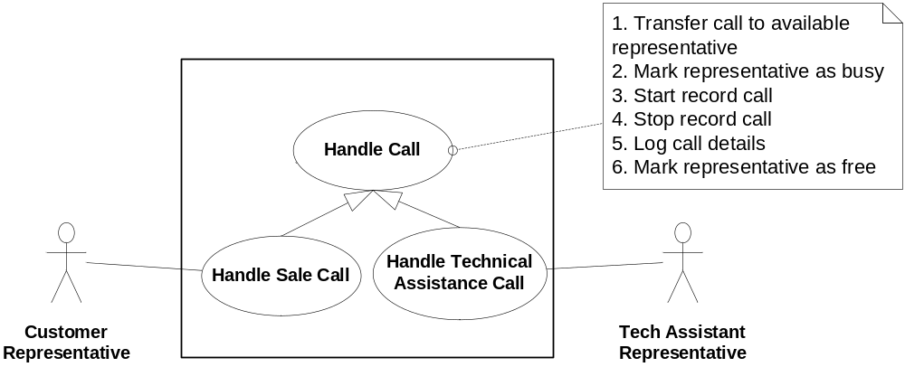
Generalization between Use-Cases
The child use case inherits the behavior parent use case:
  The interaction (described in the textual description)
  Use case links (associations, include, extend, generalization)
Child use-case can substitute parent Use case
Overriding occurs through the textual description
Example
Introduction | Diagrams | Writing | Guidelines
Notes:
Why not treat Handle Call as an included part of the Handles sales call and handle technical assistance call? Because, currently, the generalizations of Handle Call are embedded within the script (between Record Call and Log Call Details). If include was used, this will not be possible.

Slide 36
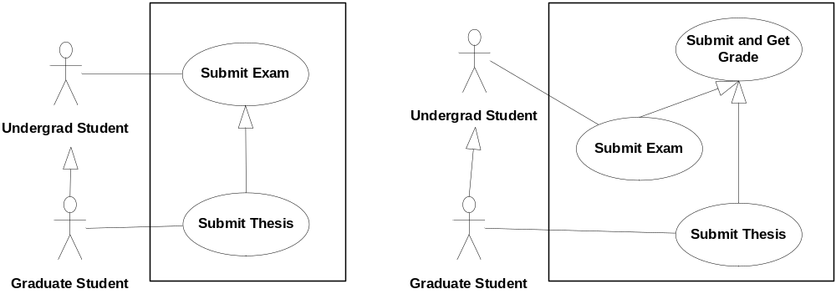
Generalization Hazards
Combining generalizations of actors and use-cases can be dangerous
Bad: Undergrad can submit thesis
Good: Only graduate student can submit thesis
Introduction | Diagrams | Writing | Guidelines
Notes:
Why the left one is unsafe? Because use-case generalization supports substitution, “Submit Thesis” can replace
“Submit Exam”, which is used directly by the undergrad student.

Slide 37

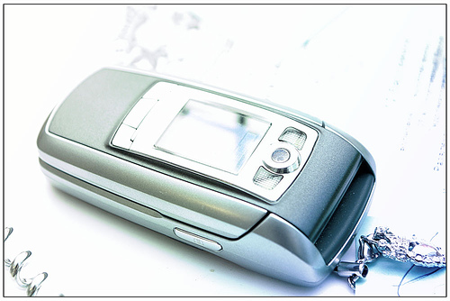


Example: Phone Company Operational System
Orange’s objective: Build a system that handles SMS messages, handles calls (for 2 and 3 generation phones), including conference calls and multiple calls from a single phone. The system must support users on the move.
Who are the actors?
The Cellular Phone
External Phone companies
Introduction | Diagrams | Writing | Guidelines

Slide 38
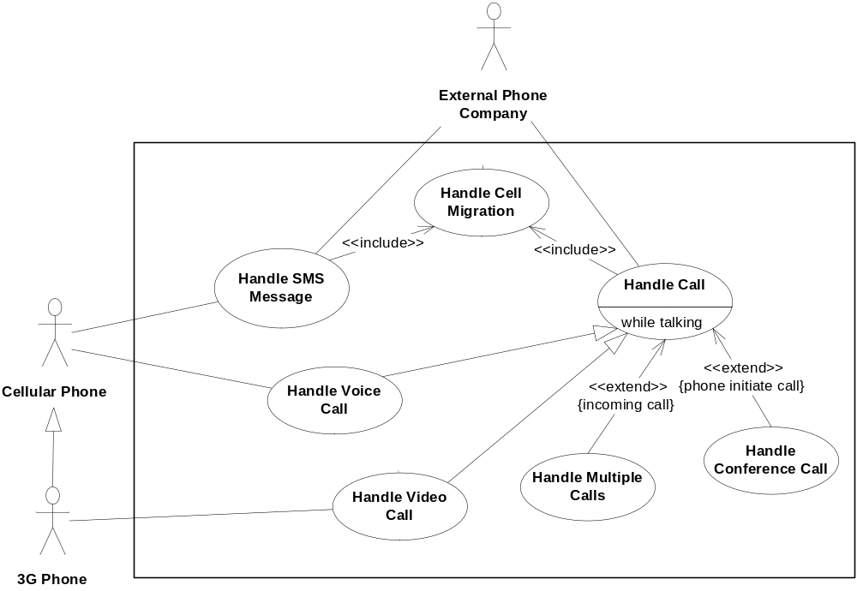
Example: Cell Company System
Introduction | Diagrams | Writing | Guidelines

Slide 39
Components of Use Case Diagram
Generalization Relationship
  Represented by a line and a hollow arrow
    From child to parent
Child use case
Parent use case
Notes:
Inheritance
A use case generalization shows that one use case is simply a special kind of another.
A clinic may have a use case such as Pay Bill which would be a parent use case and Bill Insurance which is the child.
A child can be substituted for its parent whenever necessary.
Generalization appears as a line with a triangular arrow head toward the parent use case.

Slide 40
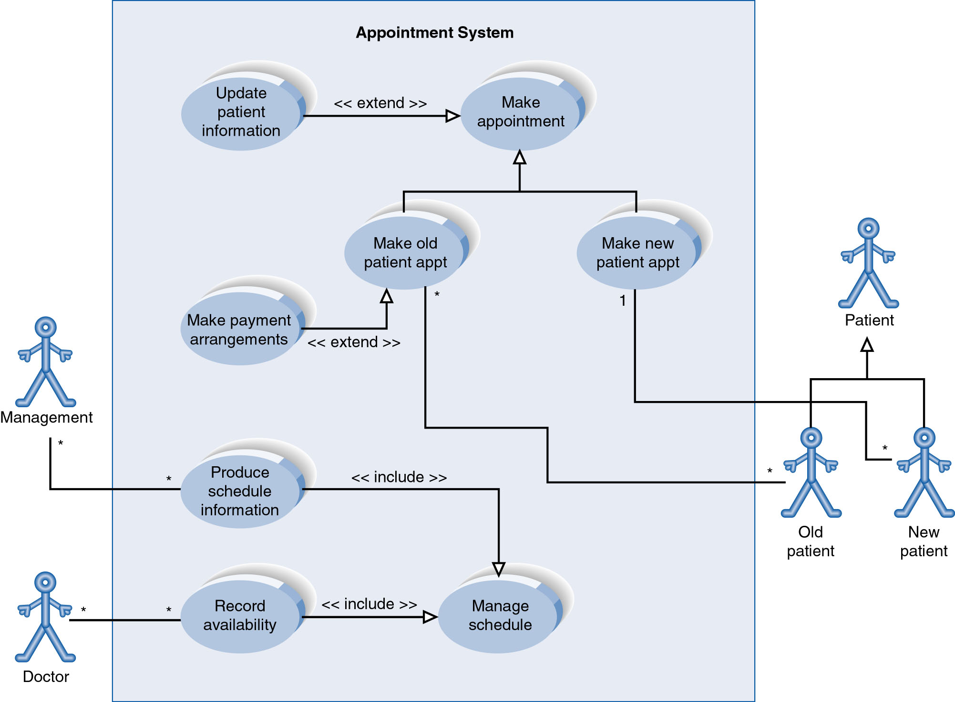
Example of Relationships
Notes:
System Boundary
Use cases are enclosed within a system boundary
a box that represents the system and clearly delineates what parts of the diagram are external or internal to it
Name of the system can appear inside or on top of the box

Slide 41
Use Case Diagram
Include Relationship
  Represents the inclusion of the functionality of one use case within another
  Arrow is drawn from the base use case to the used use case
  Write << include >> above arrowhead line
Notes:
Include relationship
Notice that ONLY between use cases (not between actors)
MANDATORY functional
Multiple use cases may share pieces of the same functionality
Rather than have duplicate functionality in several use cases
Put shared functionality in one use case and show relationship between it and other use cases that “uses” its functionality
Depicted by arrowhead with word “<<include>>” above it
Include relationships factor use cases into additional ones.
Includes are especially helpful when the same use case can be factored out of two different use cases.
If a clinic had a cases of Make Appointment and Request Medication.
Both might include Check Patient Record as a subtask.
Both would include a call to the use case Check Patient Record.
We don’t want to write it twice we simply want to include in as a call from both.
In the diagram,
include notation is a dotted line beginning at base use case ending with an arrows pointing to the include use case.
The dotted line is labeled <<include>>.

Slide 42
Use Case Diagram
Extend relationship
  Represents the extension of the use case to include optional functionality
  Arrow is drawn from the extension use case to the base use case
  Write << extend >> above arrowhead line
Notes:
Use Case Relationship
Extend relationship
Used to show optional behavior (behavior that is run only under certain circumstances)
Depicted by arrowhead with word “<<extend>>” above it
An extend relationship indicates that one use case is a variation of another.
This is often used when much of the same code may be in both only one extends the functionality somewhat.
A typical example is a add record to the database and modify that record.
So an add student is similar to a modify student so I may reuse some of the code.
Extend notation is a dotted line, labeled <<extend>>, and with an arrow toward the base case.
The extension point, which determines when the extended case is appropriate, is written inside the base case.

Slide 43
Example of Relationships
Notes:
System Boundary
Use cases are enclosed within a system boundary
a box that represents the system and clearly delineates what parts of the diagram are external or internal to it
Name of the system can appear inside or on top of the box

Slide 44
Use Case Relationships
Pro:
  Reduces redundancy in use cases
  Reduces complexity within a use case
Con
  May introduce complexity to use case diagram
Notes:
Mainly talking about extend, include, and generalization relationships.
95% of relationships on a use case diagram is association

Slide 45
Benefits of Use Cases
Use cases are the primary vehicle for requirements capture in RUP
Use cases are described using the language of the customer (language of the domain which is defined in the glossary)
Use cases provide a contractual delivery process (RUP is Use Case Driven)
Use cases provide an easily-understood communication mechanism
When requirements are traced, they make it difficult for requirements to fall through the cracks
Use cases provide a concise summary of what the system should do at an abstract (low modification cost) level.

Slide 46
Difficulties with Use Cases
As functional decompositions, it is often difficult to make the transition from functional description to object description to class design
Reuse at the class level can be hindered by each developer “taking a Use Case and running with it”. Since UCs do not talk about classes, developers often wind up in a vacuum during object analysis, and can often wind up doing things their own way, making reuse difficult
Use Cases make stating non-functional requirements difficult (where do you say that X must execute at Y/sec?)
Testing functionality is straightforward, but unit testing the particular implementations and non-functional requirements is not obvious

Slide 47
Use Case Model Survey
The Use Case Model Survey is to illustrate, in graphical form, the universe of Use Cases that the system is contracted to deliver.
Each Use Case in the system appears in the Survey with a short description of its main function.
  Participants:
    Domain Expert
    Architect
    Analyst/Designer (Use Case author)
    Testing Engineer

Slide 48
Structure of a Use Case Specification
Name
Actors
Trigger
Never Ask Tiny People Problems, Solve Always!
Preconditions
Post conditions
Success Scenario
Alistair Cockburn “Writing Effective Use Cases”
Alternatives flows
Introduction | Diagrams | Writing | Guidelines

Slide 49
Triggers
What starts the use-case?
Examples:
  Customer reports a claim
  Customer inserts card
  System clock is 10:00
Introduction | Diagrams | Writing | Guidelines

Slide 50
Preconditions
What the system needs to be true before running the use-case.
Examples
  User account exists
  User has enough money in her account
  There is enough disk space
Introduction | Diagrams | Writing | Guidelines

Slide 51
Post-Conditions
A post-condition is the outcome of the use-case.
Examples
  Money was transferred to the user account
  User is logged in
  The file is saved to the hard-disk
Minimal guarantee
  The minimal things a system can promise, holding even when the use case execution ended in failure
  Examples: Money is not transferred unless authorization is granted by the user
Success guarantee
  What happens after a successful conclusion of the use-case.
  Examples: The file is saved; Money is transferred
Introduction | Diagrams | Writing | Guidelines

Slide 52
Success Scenario
The success scenario is the main story-line of the use-case
It is written under the assumption that everything is okay, no errors or problems occur, and it leads directly to the desired outcome of the use-case
It is composed of a sequence of action steps
Example:
Interaction step
  Administrator enters course name, code and description
  System validates course code
  System adds the course to the db and shows a confirmation message
Validation Step
Internal Change Step
(plus) Interaction Step
Introduction | Diagrams | Writing | Guidelines

Slide 53
Function versus Form
Use cases
Architecture
  Use case specify function; architecture specifies form
  Use cases and architecture must be balanced

Slide 54
Use Case Diagram
We will build use case diagram for a video rental system in the examples.
Look and identify potential actors and use case tasks.
Nouns and verbs may be helpful.
Notes:
Video Rental System
Actors
Customer
Video distributer
Use cases
Enroll as member
Check out video
Return video
Order new video

